Slide 1
Collecting Presidential Histories
by the Presidential Archives of Korea
March 14. 2012
by Son, Yong-bae
National Archives of Korea
Presidential Archives
Notes:
0
장관, 차관, 원장 뜻 받아서….
필요한 것 반영해야 함

Slide 2
Table of Contents
Ⅰ. Why Presidential records important
Ⅱ. Introduction Presidential Archives of Korea
Ⅲ. Effort to collecting Korean presidential histories
IV. Review Korean presidential archives collection
V. Collection campaign

Slide 3
I. Why Presidential records important
Seungjeongwon Ilgi
(the daily records of Chosun dynasty )
승정원일기
Seungjeongwon
승정원
Keep in
An essential & primary records to understanding the Chosun dynasty
An essential historical resources for Korean history studies before modern era
Presidential records
대통령기록물
Keep in
Presidential Archives
대통령기록관
An essential & primary records to understanding Korean government administration and ruling thoughts of the president
An essential historical resources for Korean history studies in modern and contemporary times
2

Slide 4
II. Introduction to Presidential Archives of Korea
Institutional History
Aug. 1969
Establishment of the "Government Archives & Records Service” under the Ministry of Government Administration
Jan. 1999
Promulgation of the "Public Records Management Act"
Apr. 2007
Enacted the “Presidential Records Act"
Nov. 2007
Establishment of the “Presidential Archives"
Apr. 2008
Opened the “Presidential Archives building“(share with NAK)
late 2014
Be reborn as the new “Presidential Archives building“ in Sejong city
3

Slide 5
II. Introduction to Presidential Archives of Korea
What is the Presidential records?
The term “Presidential records” means materials
created or received by the President, his immed
-iate staffs, or unit in the course of conducting
activities which relate to duties of the President
and personal materials
Definition
Documents
Report, letter, diary, memorandum, notebook,
pamphlet, publication, etc
Audiovisual records
Photograph, album, audio/video recording,
slide film, etc
Artifacts
Presidential symbol, gift, poster, painting,
calligraphy, etc
PresidentialRecords
Category
4
Notes:
4

Slide 6
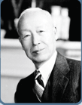
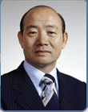
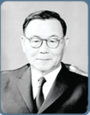
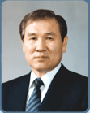
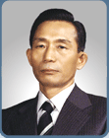
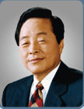
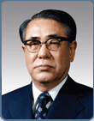
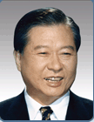
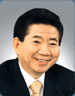
II. Introduction to Presidential Archives of Korea
Presidential records holdings
Rhee, Syngman
(1948.7~1960.4)
7,601
42,535
Chun, Doo-hwan
(1980.9~1988.2)
Yun, Po-sun
(1960.8~1962.3)
2,040
21,211
Roh, Tae-woo
(1988.2~1993.2)
8,587,567
Park, Chung-hee
(1963.12~1979.10)
37,614
17,013
Kim, Young-sam
(1993.2~1998.2)
Choi, Kyu-hah
(1979.12~1980.8)
2,261
200,814
Kim, Dae-jung
(1998.2~2003.2)
Roh, Moo-hyun
(2003.2~2008.2)
8,256,478
* unit : item
5

Slide 7
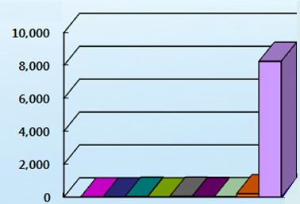
II. Introduction to Presidential Archives of Korea
Former Presidential Records Holdings Statistics
Imbalanced
Collections
holdings
(thousands)
역대 대통령별
Former presidents
Rhee,Syngman
Yun, Po-sun
Park, Chung-hee
Choi, Kyu-hah
Chun, Doo-hwan
Roh, Tae-woo
Kim, Young-sam
Kim, Dae-jung
Roh, Moo-hyun
6

Slide 8
III. Efforts to collect Korean presidential histories
Hub of the Korean Presidential Resources
Completing the collection
Collecting the scattered records
Building biographical
database of potential
donators like
Former (vice-)ministers,
secretaries and other
immediate staffs of former
presidents
Donation campaign
Contact individually
Send potential donors
a letter and promotional
materials to introduce
and appeal donation
Searching the where
-abouts of related
materials at
other foreign and local
institutions like presidential
memorial foundations
7

Slide 9
IV. Introduction to Korean presidential archives collection
Po-sun Yun (4th President) Collection
Collection donated by Sang-gu Yun(윤상구; the son of Po-sun Yun)
- Photographs of President Yun and his family
- Photographs of Po-sun Yun as a politician
- Papers regarding his liberal activities and relevant press articles
- Original autograph script of President Yun’s autobiography
- Documents including ‘Official letter for the President elects (대통령당선
통지서)’, ‘Democratic Nation-Saving Statement (민주구국선언)’ etc.
Total : 13,085 items
8
Notes:
8

Slide 10
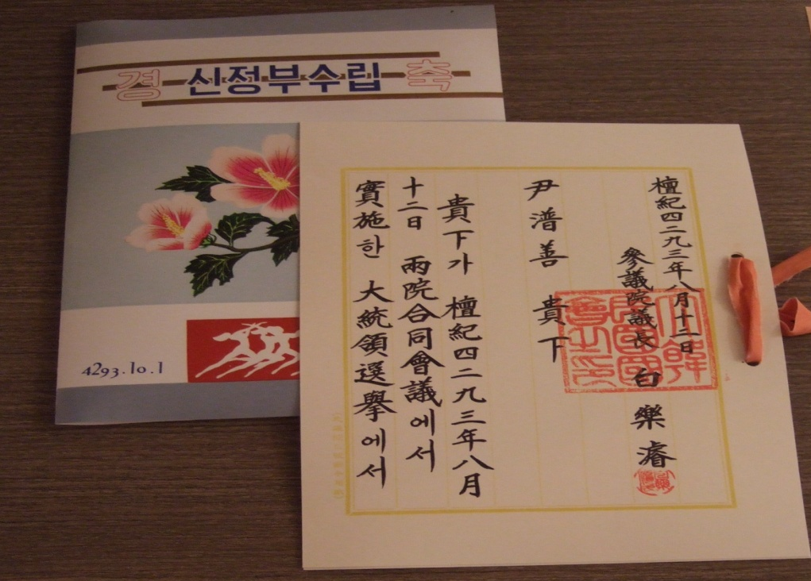
IV. Introduction to Korean presidential archives collection
Po-sun Yun Collection
Collection donated by Sang gu Yun
· 윤상구(Sang- gu Yun)
- The eldest Son of President Po-sun Yun
Donated by
Official letter for the President elects
대통령당선통지서
9
Notes:
9

Slide 11
IV. Introduction to Korean presidential archives collection
Chung-hee Park (5-9th President) Collection
Collection donated by Geun-hye Park(박근혜; the daughter of Chung-hee Park)
- Gifts received from heads of foreign countries
- Articles left by President Chung-hee Park and the first lady
Collection donated by Dr. Wan-hee Kim(김완희; Professor)
- Correspondence between President Chung-hee Park and Dr. Wan-hee Kim
regarding proposal of the way of developing korean electronic industries
Collection donated by Jae-chun Kim(김재춘; 3rd director of KCIA )
- Photographs during President Park’s military service and his presidency
- Photocopies of KCIA (중앙정보부)documents regarding 5.16 coupd’etat
Total : 3,306 items
10
Notes:
10

Slide 12
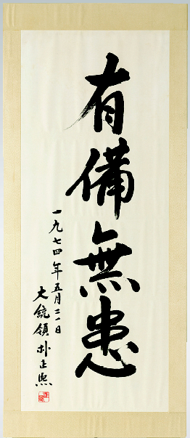
IV. Introduction to Korean presidential archives collection
Chung-hee Park Collection
· 박근혜 (Geun-hye Park)
- The daughter of President Chung-hee Park
- Politician
- Lawmaker
Donated by
President Park’s
autograph calligraphy
11
Notes:
11

Slide 13
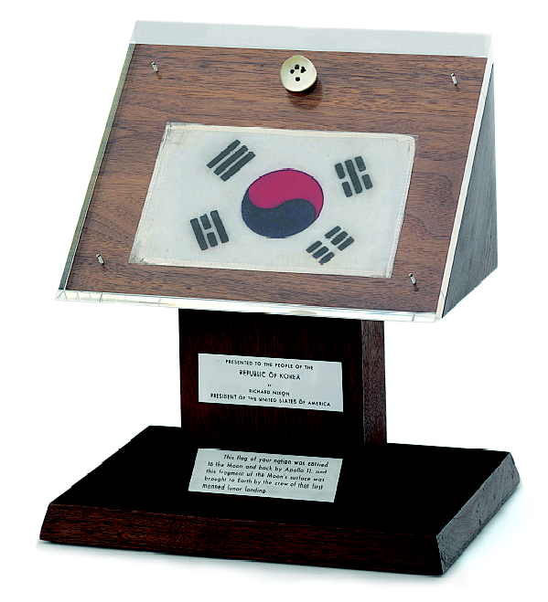
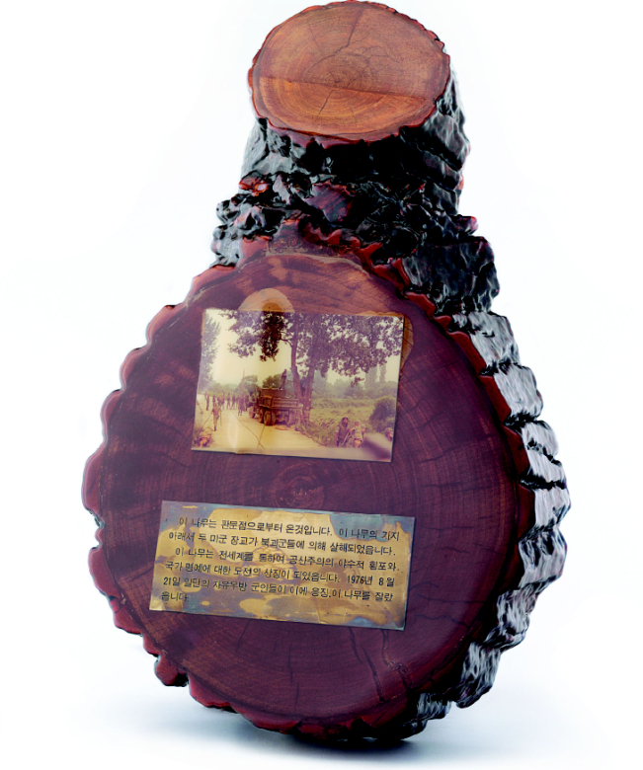
IV. Introduction to Korean presidential archives collection
Chung-hee Park Collection
Donated by Geun-hye Park
Gift from President Nixon to President Park,
the fragment of the moon’s surface with Korean
flag brought by the crew of Apollo 11
Gift from UN General Commander Stilwell to
President Park, the fragment of the cottonwood which
was trimmed in so-called “Tree incident (판문점 미루나무
사건, 1976.8.18)”
12
Notes:
12

Slide 14
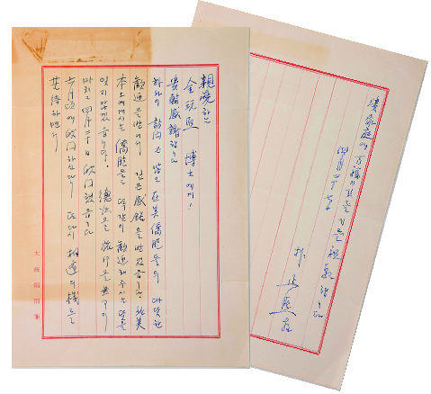
IV. Introduction to Korean presidential archives collection
Chung-hee Park Collection
· 김완희 (Dr.Wan-hee Kim)
- Former Professor at Columbia Univ.(1957~1979)
- Founder of Electronic Times (1984)
- Proposed the policy of promoting Korean electronic industry development requested by President Park and was involved in establishing KAIST
Donated by
Hand-written letter from President Chung hee Park
to Dr. Wan hee Kim(1968.4.27)
13
Notes:
13

Slide 15
IV. Introduction to Korean presidential archives collection
Kyu-hah Choi (10th President) Collection
Collection by Yun-hong Choi(the Son of Kyu-hah Choi)
- Government documents relating to Korea-U.S. summit meetings
and relation and relevant issues during the 1960s~1970s
- Papers regarding South-North Korea relation including the joint communique
of 4 July ,1972 (7.4 남북공동성명),
a South-North Korea joint agreement (남북공동성명 합의서), etc
- Papers regarding diplomatic relation during Kyu-hah Choi’s presidency as
a foreign minister(1967~1971)
- Kyu-hah Choi’s hand written hospital diary about Gi Hong (the first lady)
Total : 15,887 items
14
Notes:
14

Slide 16
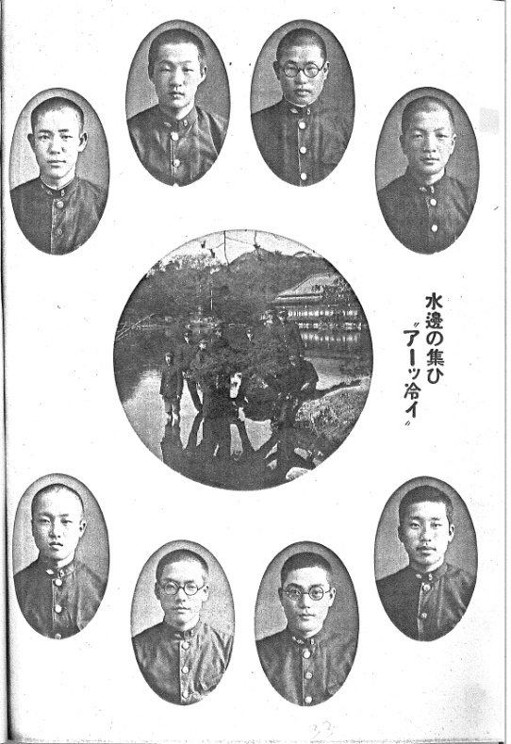
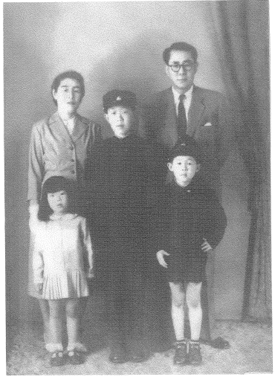
IV. Introduction to Korean presidential archives collection
Kyu-hah Choi Collection
· 최윤홍 (Yun-hong Choi)
- The eldest son of 10th President Kyu-hah Choi
Donated by
Photo from President Choi’s high school year book
Photo of President Choi’s family
15
Notes:
15

Slide 17
IV. Introduction to Korean presidential archives collection
Young-sam Kim (14th President) Collection
Collection by Young-sam Kim(14th President)
- Medals, Martin Luther King Peace award, painting, calligraphy
- Books, Public speeches, Press releases, Briefings
- A/V materials during his presidency
Collection by Yong-duk Kim(Former Governor of the Financial Supervisory Service )
- Government documents relating to IMF foreign currency crisis and its process,
decision making process, etc. during the Young-sam Kim Administration
Collection by Yang-bu Choi(Senior Secretary)
- Government documents relating to Agriculture policies during the Young-
sam Kim Administration
Total : 21,727 items
16
Notes:
16

Slide 18
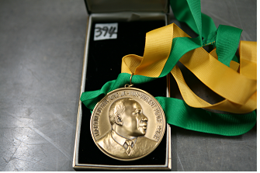
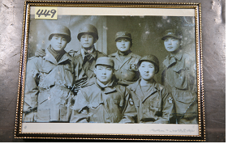
IV. Introduction to Korean presidential archives collection
Young-sam Kim Collection
· 김영삼 (Young-sam Kim)
- The 14th President
Donated by
The Martin Luther King Jr.
nonviolent peace prize
(1995.1.26)
Photo in his year of
military service during
Korean war(1950.12.30)
17
Notes:
17

Slide 19
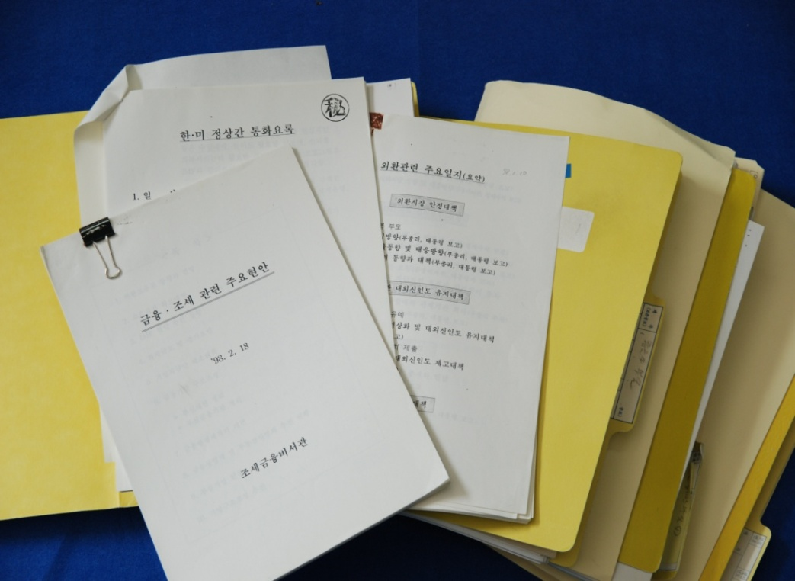
IV. Introduction to Korean presidential archives collection
Young-sam Kim Collection
· 김용덕 (Yong-duk Kim)
- Staff for the Presidential Secretariat (1996~1998)
- Former Governor of the Financial Supervisory Service
Donated by
Documents regarding IMF foreign currency crisis and financial issues during the Young-sam Kim administration
18
Notes:
18

Slide 20
IV. Introduction to Korean presidential archives collection
Presidential Oral histories
Total : 538 hours/96 Interviewees
Presidents
Interviewees
Syngman Rhee
Family member and persons in politics, foreign affairs(ex]이철승, 박동진, 이인수/10persons)
Po-sun Yun
Family members and secretary (ex] 윤상구, 윤동구 / 9persons)
Chung-hee Park
Persons in politics, economy, national security, etc(ex]김계원, 고건, 노신영 / 43persons)
Doo-hwan Chun
Persons in finance, culture, agriculture, etc(ex]사공일, 이원홍, 김주호 / 10persons)
Tae-woo Roh
The first lady and persons in politics (ex]김옥숙 여사, 박철언, 정원식 /11persons)
Young-sam Kim
President Young sam Kim and persons in economy(ex]강경식,이홍구/13persons)
19
Notes:
19

Slide 21
IV. Introduction to Korean presidential archives collection
Interview with Young-sam Kim, 14th President
20
Notes:
20

Slide 22
V. Introduction to collection campaigns
• Collecting presidential materials possessed by individuals and organizations overseas
- Every materials in regards to Korean Presidents’ official duties as well as
their private lives
- Every materials in regards to historical events and issues happened during
their presidency
• Collecting Korean materials possessed by individuals and organizations overseas
- Every materials in regards to the history of Korean immigrants
- Every materials in regards to Korea before 1945
If you have any relevant items or information, please contact
Presidential Archives of the National Archives of Korea
21
Notes:
21

Slide 23
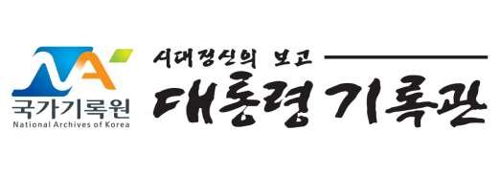
How to Contact
Presidential Archives, the National Archives of Korea
- Email ) mikay@korea.kr
- Tel ) 82-31-750-2141
- Fax) 82-31-750-2150
22
Notes:
22

Slide 24
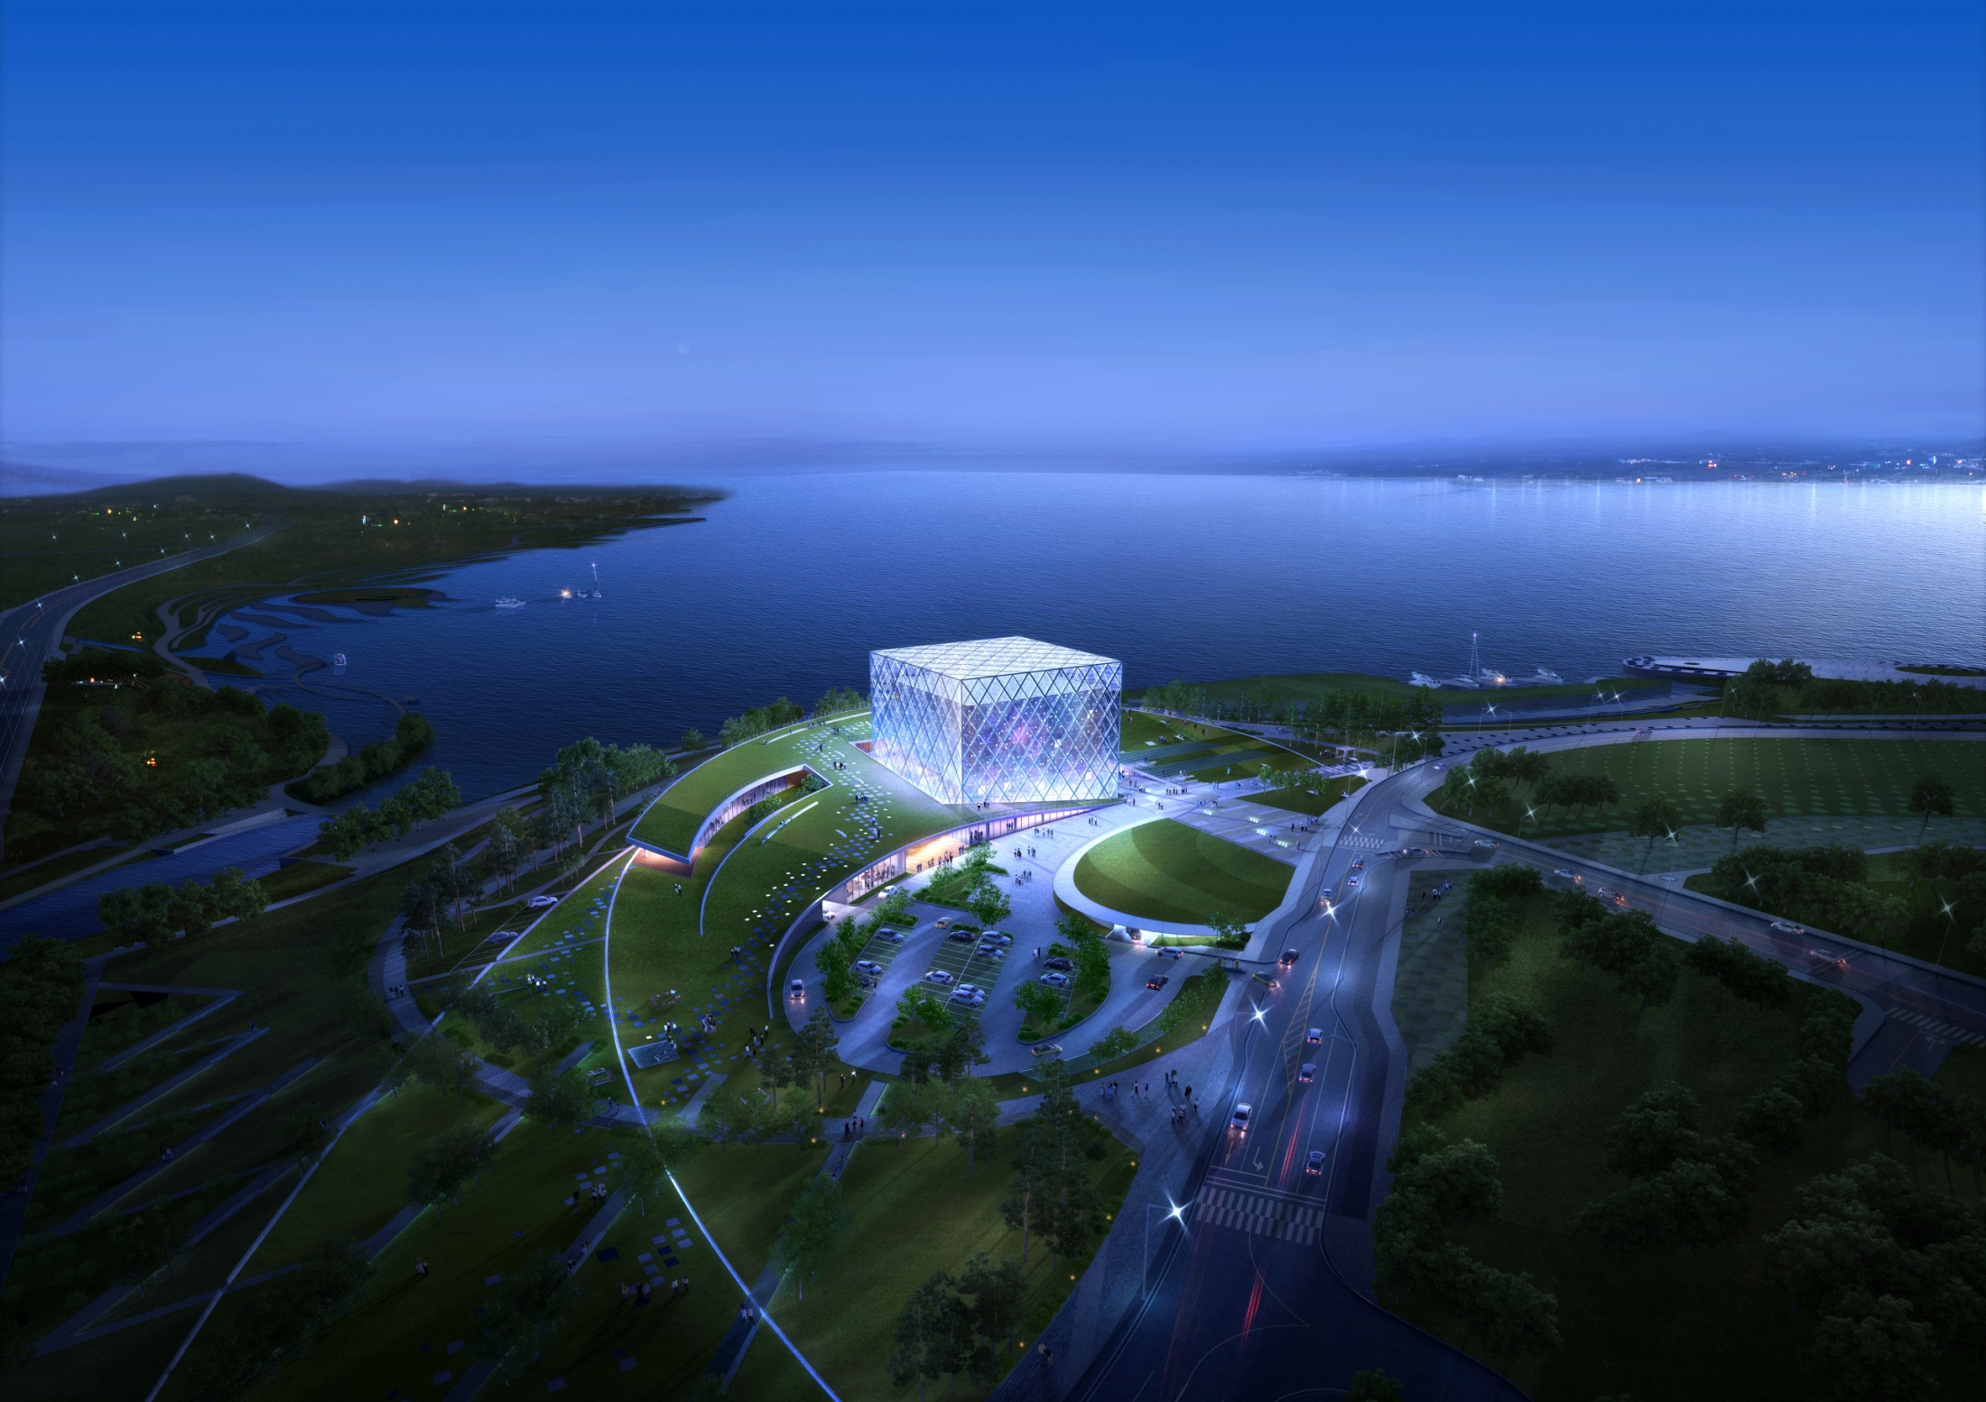
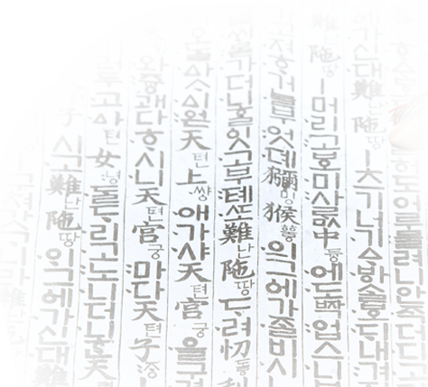
Thank you!
Aerial View of Korean Presidential Archives in Sejong city
(Construction Completed in 2014)

